Slide 1

Proposition Knowledge Graphs
Gabriel Stanovsky Omer Levy Ido Dagan
Bar-Ilan University
Israel
Notes:
Hello, I’m Gabi Stanovsky from Bar Ilan University, and ill be presenting a joint work with Omer levy and ido Dagan .
This is a position paper describing the initial design of a representation framework for information discovery which we call proposition knowledge graph

Slide 2

Problem
End User
Notes:
Information discovery requires taking into account natural language information which might be found within different levels.
within a single sentence
a single document
or across multiple documents.
And presenting it efficiently to an and user – either a human being or a semantic application.

Slide 3
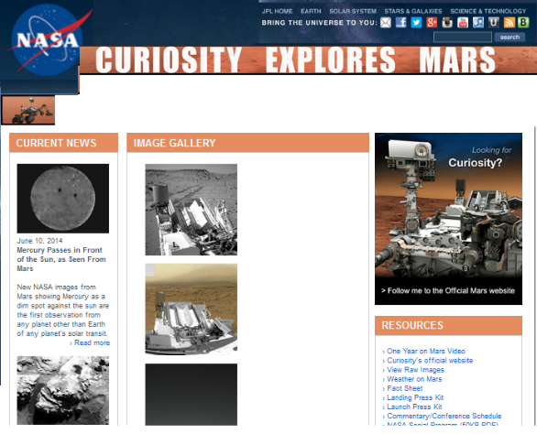
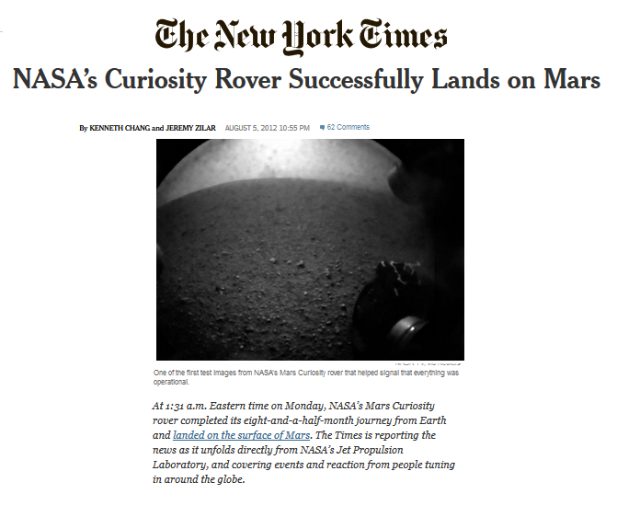
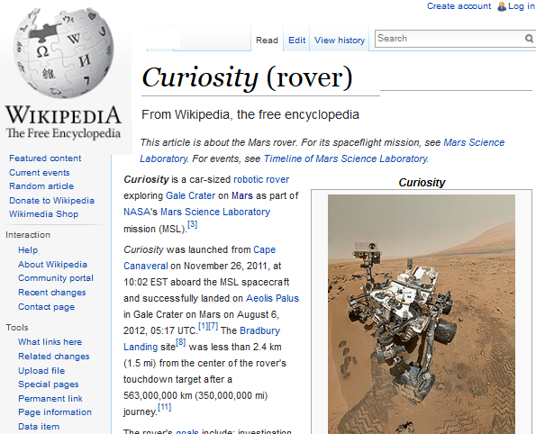
Case Study: Curiosity (Mars Rover)
Curiosity is a fully equipped lab.
Curiosity is a rover.
Mars rover Curiosity will look for environments where life could have taken hold.
The Mars rover Curiosity is a mobile science lab.
Curiosity will look for evidence that Mars might have had conditions for supporting life.
Curiosity, the Mars rover, functions as a mobile science laboratory.
Curiosity successfully landed on Mars.
Mars rover Curiosity successfully landed on the red planet.
Notes:
As a test case we will follow throughout this representation we will use the Curiosity Mars rover - a land rover NASA has sent in 2012 to survey the surface of Mars.
As most contemporary events - information on the subject is abundant
We would like to provide a useful representation for this data, either for a human being, or a semantic application.

Slide 4
Goal: Representation for Information Discovery
Representing a Single Sentence: Captures maximum of the meaning conveyed
Consolidation Across Multiple Sentences: Groups semantically-equivalent propositions
Traversable Representation: Allows its end user to semantically navigate its structure
Notes:
Our goal is to find a representation which will capture and organize information for information discovery.
We want to be able to represent the information:
Expressive We would like to represent as much as a human listener would understand from a single sentence.
Consolidated We want to group elements of the representation according to semantic relations between them. This is important when dealing with large overlapping corpus, as often semantic applications need to do.
Traversable Giving its end user – either a human being, or a semantic application – the power to find its information by traversing the representation, rather then exhaustively searching the elements of the representation.
In the rest of our presentation we will deal with providing solutions for these issues within a single framework.

Slide 5
Talk Outline
Single Sentence Representation
SRL
AMR
Open-IE
Proposition Structure
Proposition Knowledge Graphs
From Single to Multiple Sentence Representation
Notes:
In the rest of the representation we will:
survey existing frameworks for representing a single sentence, followed by presenting our single sentence representation.
Concluding with a scheme to extend the representation to a multiple sentence representation – Proposition Knowledge graphs

Slide 6
SRL AMR Open-IE
Representing a Single Sentence
Existing Frameworks
Notes:
So let’s begin by looking at SRL

Slide 7
Semantic Role Labeling (SRL)
Maps predicates and arguments in a sentence to a predefined ontology
Existing ontologies:
PropBank
FrameNet
NomBank
Notes:
The first representation we we’ll survey is SRL – a much studied task, which aims at mapping predicates and argument in a given sentence onto a predefined ontology of predicates and their possible arguments.
Several such ontologies were created – among the popular ones we can name PropBank, Framenet and NomBank

Slide 8
Semantic Role Labeling (SRL)
“Curiosity successfully landed on Mars, after entering its atmosphere.”
Notes:
Lets look at a sentence :
Curiosity successfully landed on Mars, after entering its atmosphere.
SRL will identify two predicates – landed and entering

Slide 9
Semantic Role Labeling (SRL)
“Curiosity successfully landed on Mars, after entering its atmosphere.”
thing landing
time
manner
location
place entered
entity entering
Notes:
For each predicate, arguments are identified according to a lexicon and a predetermined list of roles
- “Thing landing”, for example, is a specific argument taken from the Propbank frame for “land”

Slide 10
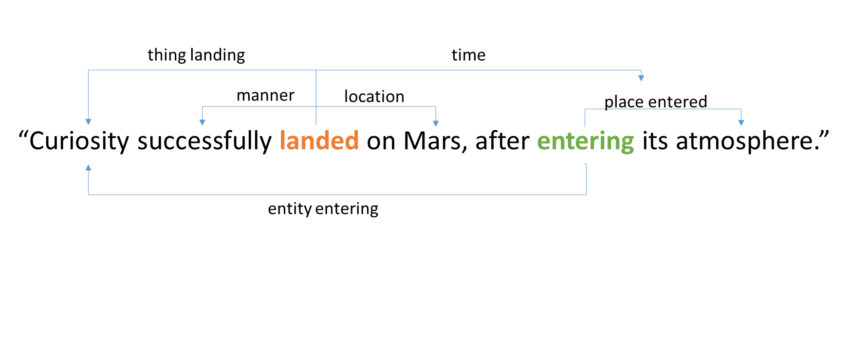
Semantic Role Labeling (SRL)
Pros | Cons
✔ Semantically expressive | ✘ Misses propositions “Mars has an atmosphere”
 | ✘ Relies on an external lexicon such as Propbank
Notes:
Looking at SRL with respect to the properties we set out to find in our representation, we find:
On one side:
Expressive – As it Aims at conveying the semantic relations of the sentence
On the downside:
It misses propositions – for instance, in this sentence, the proposition that “Mars has an atmosphere” is not clearly represented
lastly
It uses a human-generated lexicon, and therefore it is bounded by its vocabulary

Slide 11
SRL AMR Open-IE
Representing a Single Sentence
Existing Frameworks
Notes:
Another semantic representation which gathered a lot of interest recently is AMR,

Slide 12
Abstract Meaning Representation (AMR)
Maps a sentence onto a hierarchical structure of propositions
Uses PropBank for predicates, where possible
Notes:
AMR maps sentences onto an hierarchical predicate-argument structure
Uses PropBank frames where possible, and ungrounded predicates otherwise, if no appropriate propBank frame exists

Slide 13
Abstract Meaning Representation (AMR)
“Curiosity successfully landed on Mars, after entering its atmosphere.”
(l / land-01
:arg1 (c / Curiosity)
:location (m / Mars)
:manner (s / successful)
:time (b / after
:op1 (e / enter-01
:arg0 c
:arg1 (a / atmosphere
:poss m))))
Notes:
Using the previous sentence again we can see how AMR will represent a sentence:
A rooted tree representing the meaning of the sentence.
We can see the same Propbank frames appearing as in the SRL representation – land, entering, and their arguments.
As oppose to SRL, AMR draws a logical relation between the two predicates.
In this case – a temporal relation.

Slide 14
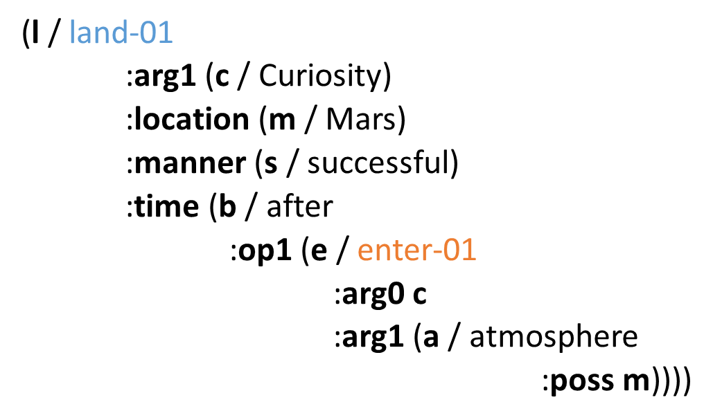
Abstract Meaning Representation (AMR)
Pros | Cons
✔ Semantically expressive | ✘ Imposes a rooted structure “Mars has an atmosphere”
✔ Unbounded by lexicon | ✘ Requires deep semantic analysis
Notes:
Pros:
Semantically expressive, as it deals with uncovering the semantic properties of the sentence
Unbounded by lexicon – can somewhat deal with out-of-lexicon predicates
Cons:
Enforces the representation to be a rooted structure – and therefore cannot provide discrete independent propositions (such as “Mars has as an atmosphere”) As oppose to SRL – which didn’t capture at all the extraction that Mars has an atmosphere – in AMR this representation is hidden deep inside the representation.
Requires a deep semantic analysis to obtain “the meaning representation” of the sentence, which currently renders it to be very domain independent

Slide 15
SRL AMR Open-IE
Representing a Single Sentence
Existing Frameworks
Notes:
The last representation we will survey is Open Information Extraction or Open-IE

Slide 16
Open Information Extraction (Open IE)
Extracts propositions from text based on surface/syntactic patterns
Represents propositions as predicate-argument tuples
Each element is a natural language string
Notes:
Finally, lets look at Open Information Extraction
As oppose to the previous approaches we’ve surveyed, Open IE doesn’t map to a predefined ontology, instead
It extracts predicate-argument tuple using syntactic patterns
And uses the surface form in which they appeared

Slide 17
Open Information Extraction (Open IE)
“Curiosity successfully landed on Mars, after entering its atmosphere.”
((“Curiosity”, “successfully landed on”, “Mars”);
ClausalModifier: “after entering its atmosphere”)
Notes:
Lets revisit our example -
Open IE discovers a single proposition –
“Successfully landed on”, without breaking it into an inner structure.
The second proposition – “entering its atmosphere” serves as an atomic clausal modifier, without further analyzing of the “entering” proposition.

Slide 18
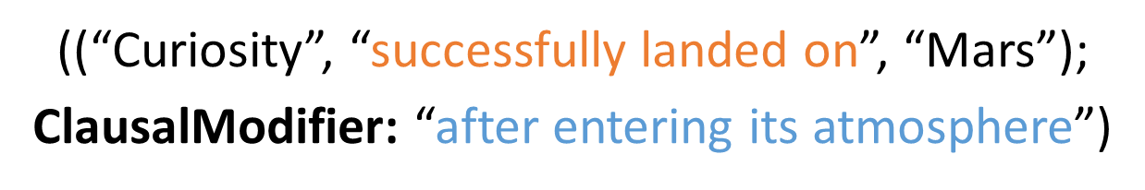
Open Information Extraction (Open IE)
Pros | Cons
✔ Unbounded by lexicon Uses syntactic patterns | ✘ Misses propositions “Mars has an atmosphere”
✔ Extracts discrete propositions Information retrieval scenario | ✘ Does not analyse semantics
Notes:
So Open IE
Unbounded by lexicon – represents based on syntactic patterns
Extracts discrete propositions – no need to extract from a rooted structure This is important in scenarios such as IR or QA, where a list of independent “facts” might come in handy
On the downside:
It misses propositions – certain propositions cannot be represented, such as that Mars has an atmosphere
It does not analyze semantic relations between extractions, just outputs a list of independent extractions

Slide 19
Representing a Single Sentence Consolidation Across Multiple Sentences Traversing the Representation
Proposition Knowledge Graphs
Notes:
<Deep breath>
TODO: maybe add the minimap – and add Proposition structure in blue – not sure how will this fit in the flow, after that slide will come this slide? That will look awkward
We now move on to designing our representation – a work which is still in progress, beginning with dealing with a single sentence’s representation, and afterwards moving on to representing information from multiple sources.

Slide 20
Representing a Single Sentence
“Curiosity will look for evidence that Mars might have had conditions for supporting life.”
Notes:
We would like to adopt the methodology of open-ie for representing the propositions conveyed by the text, and extend its expressiveness to correctly capture more complex relations.

Slide 21
Representing a Single Sentence
“Curiosity will look for evidence that Mars might have had conditions for supporting life.”
Predicate: look for
Tense: future
Subject: Curiosity
Object: evidence
Predicate: have
Tense: future
Modality: might
Subject: Mars
Object: conditions
Predicate: supporting
Object: life
Nodes are propositions
Notes:
Instead of using tuples - A single sentence is represented as a graph of propositions conveyed from syntax – A proposition structure.
Nodes are propositions
Predicate and a set of arguments
Syntactic properties are encoded within the node
So in this sentence we have three propositions: look for, have and supporting
And for example, look for is encoded with tense feature of future

Slide 22
Representing a Single Sentence
“Curiosity will look for evidence that Mars might have had conditions for supporting life.”
Predicate: look for
Tense: future
Subject: Curiosity
Object: evidence
Predicate: have
Tense: future
Modality: might
Subject: Mars
Object: conditions
Predicate: supporting
Object: life
Edges are syntactic relations
Notes:
The edges in the graph are syntactic relations between propositions.

Slide 23
Representing a Single Sentence
“Curiosity will look for evidence that Mars might have had conditions for supporting life.”
Predicate: look for
Tense: future
Subject: Curiosity
Object: evidence
Predicate: have
Tense: future
Modality: might
Subject: Mars
Object: conditions
Object
Predicate: supporting
Object: life
Edges are syntactic relations
Notes:
For instance – Conditions for supporting life is the Object of look for

Slide 24
Representing a Single Sentence
Propositions can be implied from syntax
Implied propositions can also be introduced by adjectives, nominalizations, conjunctions, and more
Possessives
Curiosity’s robotic arm is used to collect samples
Curiosity has a robotic arm
Apposition
Curiosity, the Mars rover, landed on Mars
Curiosity is the Mars rover
Notes:
In addition to extending the expressiveness of open-IE, we would also like to represent implied propositions
We intend on representing all of the propositions conveyed by the syntax itself to a human listener.
So, if we look at the sentence : Curiosity’s robotic arm is used to collect samples – a human listener will gather that Curiosity has a robotic arm
Apposition is another construction missed by the open-ie paradigm, lets look at the sentence: Curiosity, the Mars rover, landed on Mars It clearly implies that Curiosity is the mars rover
And this phenomena can appear in other constructions, such as adjectives, nominalizations, conjunctions, and more
Open IE system will not be able to capture and represent this kind of information, as it is implicit in the text

Slide 25
Proposition Knowledge Graphs (PKG)
Pros | Cons
✔ Marks implied propositions ”Curiosity has a robotic arm” | ✘ Does not analyse semantics
✔ Marks discrete propositions along with inner structure
✔ Unbounded by lexicon
Notes:
Reviewing our propositions
We mark implied propositions (such as curiosity has a robotic arm)
We mark discrete propositions along with their inner structure as we’ve seen in the example – we do not impose a rooted structure, but instead provide a graph
Unbounded by lexicon – as we do not use semantic roles.
And that is exactly the downside - we do not analyze the semantic structure of the sentence Hopefully the lack of semantics:
Provides a more feasible framework, compared with SRL and AMR
Will be added in a second phase, via consolidation of different sentences.

Slide 26
Proposition Knowledge Graphs (PKG)
We have seen:
PKG adopts Open-IE robustness
PKG improves over its expressiveness
Semantic relations are left for higher level representation
Which we will see next
Notes:
So we maintained the robustness of Open-IE while improving its expressiveness
- Next we will deal with representing multiple sentences.

Slide 27
Representing a Single Sentence Consolidation Across Multiple Sentences Traversing the Representation
Proposition Knowledge Graphs
Notes:
<Deep breath>
Let’s move on from representing a single sentence to representing multiple sentences

Slide 28
Consolidation
Proposition structures serve as backbone for higher level representation
Predicate: look for
Tense: future
Subject: Curiosity
Object: evidence
Predicate: have
Tense: future
Modality: might
Subject: Mars
Object: conditions
Predicate: supporting
Object: life
Curiosity will look for evidence that Mars might have had conditions for supporting life.
Notes:
As a backbone of our representation, each sentence is represented via proposition structures.
So, if we are looking at the sentence we’ve just seen before,
- It will be represented internally with the proposition structure which we’ve just defined

Slide 29
Consolidation
Semantic edges are drawn between sentences
Entailment
Temporal
Conditional
Causality
Notes:
Given that representation, we would like to add semantic edges between sentences, such edges might be
Entailment
Temporal
Conditional
Causality
And more.
Let’s look at a few examples where these edges might be drawn

Slide 30
Paraphrases
NASA utilizes the Mars rover, Curiosity, to examine rock samples from Mars
paraphrase
NASA uses Curiosity rover, to take a closer look at rock samples found on Mars
Notes:
A paraphrase link will form cliques of redundant information
- When observing a new sentence, which we identify as a paraphrase of an existing sentence – we will draw a bidirectional link, so applications will know that they are dealing with rephrasing of an existing information, rather than new information.

Slide 31
Entailment
Curiosity is a rover.
entailment
NASA utilizes the Mars rover, Curiosity, to examine rock samples from Mars
NASA uses Curiosity rover, to take a closer look at rock samples found on Mars
Notes:
An entailment link will be drawn when new information is observed, and it relates to previous information by means of entailment
– For example, The sentence “curiosity is a mars rover” is entailed from the previous clique
this impose a Specific to General order while an application is traversing this sort of graph.

Slide 32
Temporal
Curiosity is a rover.
entailment
NASA utilizes the Mars rover, Curiosity, to examine rock samples from Mars
NASA uses Curiosity rover, to take a closer look at rock samples found on Mars
temporal
Curiosity successfully landed on Mars.
Notes:
Finally A temporal link will mark temporal succession between the propositions.
So, when receiving the sentence “Curiosity successfully landed on Mars”, when we decide, by means of semantic analysis that this event preceded other propositions we already represented – we can draw a temporal link within our representation
Other semantic links might be drawn between propositions, such as: conditional, causation, and more.

Slide 33
Representing a Single Sentence Consolidation Across Multiple Sentences Traversing the Representation
Proposition Knowledge Graphs
Notes:
<Deep breath>
Finally, we would like to show that it is possible to traverse this representation, looking for some desired information, either at a single sentence level, or at multiple sentence level.

Slide 34
Curiosity is a rover.
entailment
NASA utilizes the Mars rover, Curiosity, to examine rock samples from Mars
Q: “What did Curiosity do after landing?”
NASA uses Curiosity rover, to take a closer look at rock samples found on Mars
temporal
Curiosity successfully landed on Mars.
Mars rover Curiosity successfully landed on the red planet.
Notes:
Returning to our previous graph:
A query from an end user would like to know “what did curiosity do after landing?”

Slide 35
Curiosity is a rover.
entailment
NASA utilizes the Mars rover, Curiosity, to examine rock samples from Mars
Q: “What did Curiosity do after landing?”
NASA uses Curiosity rover, to take a closer look at rock samples found on Mars
temporal
Curiosity successfully landed on Mars.
Mars rover Curiosity successfully landed on the red planet.
Notes:
The end user can:
find the relevant edge, describing the landing of curiosity
And travel along a temporal link, to find several things that curiosity do after landing – everything within this clique

Slide 36
Predicate: utilize
Subject: NASA
Object: the Mars rover Comp: examine
Predicate: examine
Subject: the Mars rover Object: rock samples
rock samples
Modifier: from Mars
NASA utilizes the Mars rover to examine rock samples from Mars
Notes:
In addition, other queries might be answered from a single sentence’s representation:
Looking at the sentence “NASA utilizes the Mars rover to examine rock samples from Mars”
- And it appropriate Proposition structure
We can answer the questions:

Slide 37
Predicate: utilize
Subject: NASA
Object: the Mars rover Comp: examine
Predicate: examine
Subject: the Mars rover Object: rock samples
rock samples
Modifier: from Mars
NASA utilizes the Mars rover to examine rock samples from Mars
Q: “Who utilizes the Mars rover?”
Notes:
like
“Who utilizes the Mars rover?”

Slide 38
Predicate: utilize
Subject: NASA
Object: the Mars rover Comp: examine
Predicate: examine
Subject: the Mars rover Object: rock samples
rock samples
Modifier: from Mars
NASA utilizes the Mars rover to examine rock samples from Mars
Q: “Who utilizes the Mars rover?”
Q: “What did the Mars rover examine?”
Notes:
And
“What did the Mars rover examine?”
So our representation is traversable both at the sentence level as well at multi-sentence level.

Slide 39
Challenges (Ongoing Work)
Extract rich propositions from text
Extract inter-proposition relations implied by text
Discover semantic relations between sentences not implied by text
Thank you for listening!
Notes:
<Deep breath>
So, as this is an ongoing work, the challenges left are:
Extract rich propositions from text, which will fit the representation scheme we described
and embed them within the single sentence representation
to discover semantic relations between propositions not implied by text, but by other outer knowledge, as the Entailment relation.
Thank you for listening

